Slide 1
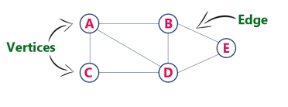


UNIT 5 What is a graph?
A data structure that consists of a set of nodes (vertices) and a set of edges that relate the nodes to each other
The set of edges describes relationships among the vertices
Example: graph G can be defined as G = ( V , E ) Where V = {A,B,C,D,E} and
E = {(A,B),(A,C)(A,D),(B,D),(C,D),(B,E),(E,D)}.

Slide 2
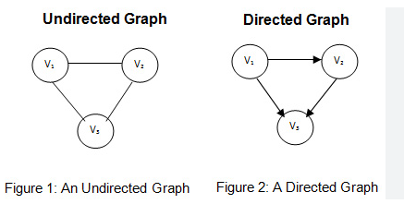
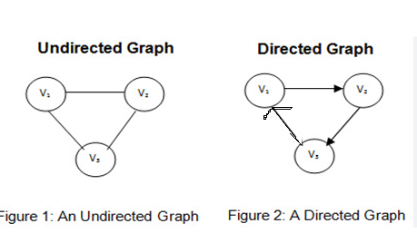
Types of a graph Directed vs. undirected graphs
When the edges in a graph have a direction, the graph is called directed –(V1,V2),(V2,V3) & (V3,V1)
When the edges in a graph have no direction, the graph is called undirected –(V1,V2),(V2,V3) & (V3,V1)

Slide 3
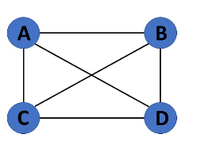
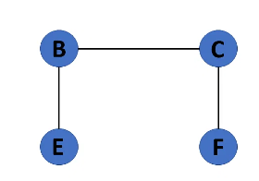
Graph terminology (cont.)
Cyclic Graph
If a graph contains at least one graph cycle, it is considered to be cyclic.
Acyclic Graph
When there are no cycles in a graph, it is called an acyclic graph.
Cyclic Graph
Acyclic Graph

Slide 4
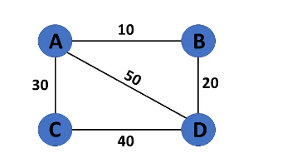
Graph terminology (cont.)
Weighted Graph
Graph G= (V, E) is called a labeled or weighted graph because each edge has a value or weight representing the cost of traversing that edge.

Slide 5
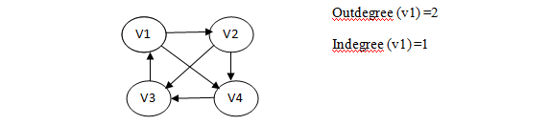
Graph terminology (cont.)
Degree
The number of edges incident on a vertex determines its degree. The degree of the vertex is written as degree (v). The in degree of the vertex V is the number of edges entering into vertex V. Similarly the out degree of the vertex V is the number of edges existing fro that vertex V.

Slide 6
Graph implementation
Representations of Graph
Here are the two most common ways to represent a graph :
Adjacency Matrix
Adjacency List

Slide 7
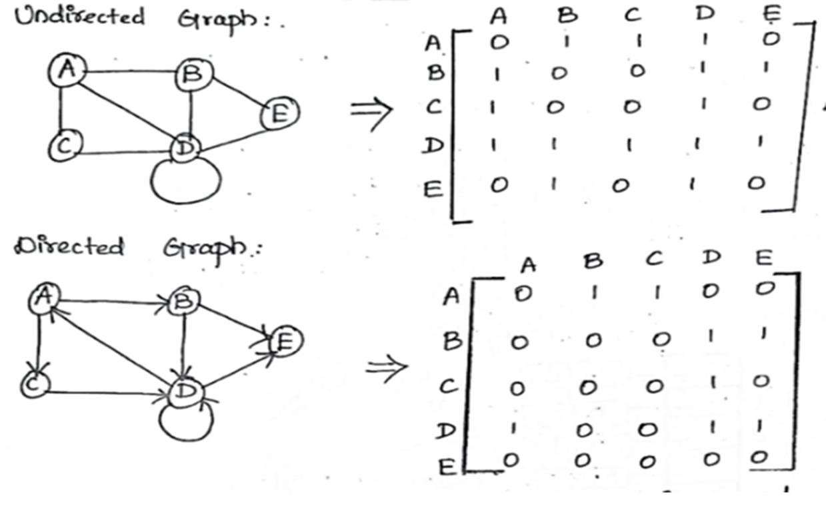
Array-based implementation
Adjacency Matrix

Slide 8
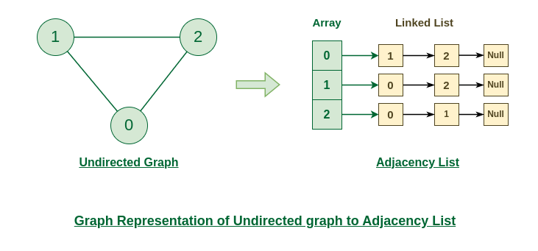
Graph implementation (cont.)
Linked-list implementation
A 1D array is used to represent the vertices
A list is used for each vertex v which contains the vertices which are adjacent from v (adjacency list)
Representation of Undirected Graph to Adjacency list:

Slide 9
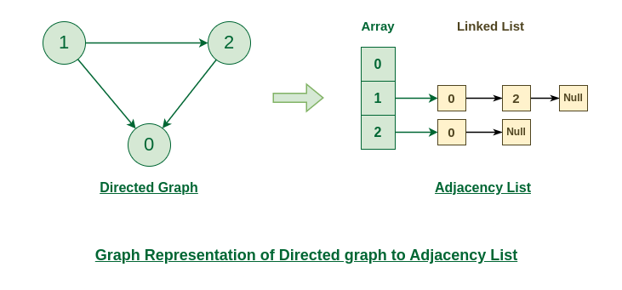
Graph implementation (cont.)
Linked-list implementation
A 1D array is used to represent the vertices
A list is used for each vertex v which contains the vertices which are adjacent from v (adjacency list)
Representation of Directed Graph to Adjacency list:

Slide 10

Adjacency Matrix and List-Pros and Cons
Matrix:
Pros:
Simple to implement
Easy and fast to tell if a pair (i,j) is an edge: simply check if A[i][j] is 1 or 0
Cons:
No matter how few edges the graph has, the matrix takes O(n2) in memory
LIST:
Pros:
Saves on space (memory): the representation takes as many memory words as there are nodes and edge.
Cons:
It can take up to O(n) time to determine if a pair of nodes (i,j) is an edge: one would have to search the linked list L[i], which takes time proportional to the length of L[i].

Slide 11
Review Questions
Draw a directed graph with five vertices and seven edges. Exactly one of the edges should be a loop, and do not have any multiple edges.
Draw an undirected graph with five edges and four vertices. The vertices should be called v1, v2, v3 and v4--and there must be a path of length three from v1 to v4. Draw a squiggly line along this path from v1 to v4.
Draw the edge lists that correspond to the graph from the previous question.
What are the benefits of using an external iterator as opposed to an internal iterator?

